Slide 1
Chapter 13
Enhanced Entity-Relationship Modeling

Slide 2

Chapter 13 - Objectives
Limitations of basic concepts of the ER model and requirements to represent more complex applications using additional data modeling concepts.
Most useful additional data modeling concept of Enhanced ER (EER) model is called specialization/generalization.
A diagrammatic technique for displaying specialization/generalization in an EER diagram using UML.

Slide 3
Enhanced Entity-Relationship Model
Since 1980s there has been an increase in emergence of new database applications with more demanding requirements.
Basic concepts of ER modeling are not sufficient to represent requirements of newer, more complex applications.
Response is development of additional ‘semantic’ modeling concepts.

Slide 4

Specialization / Generalization
Superclass
  An entity type that includes one or more distinct subgroupings of its occurrences.
Subclass
  A distinct subgrouping of occurrences of an entity type.

Slide 5
Specialization / Generalization
Superclass may contain overlapping or distinct subclasses.
Not all members of a superclass need be a member of a subclass.

Slide 6
Specialization / Generalization
Attribute Inheritance
  An entity in a subclass represents same ‘real world’ object as in superclass, and may possess subclass-specific attributes, as well as those associated with the superclass.

Slide 7
Specialization / Generalization
Specialization - Child
  Process of maximizing differences between members of an entity by identifying their distinguishing characteristics.
Generalization - Parent
  Process of minimizing differences between entities by identifying their common characteristics.

Slide 8
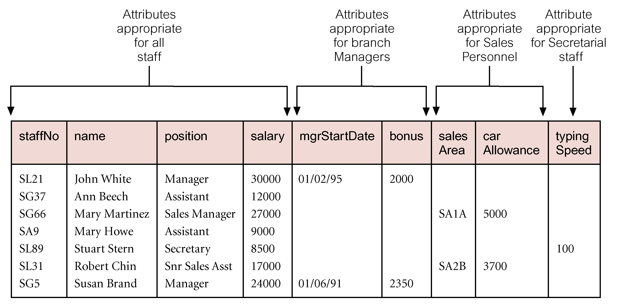
AllStaff relation holding details of all staff

Slide 9
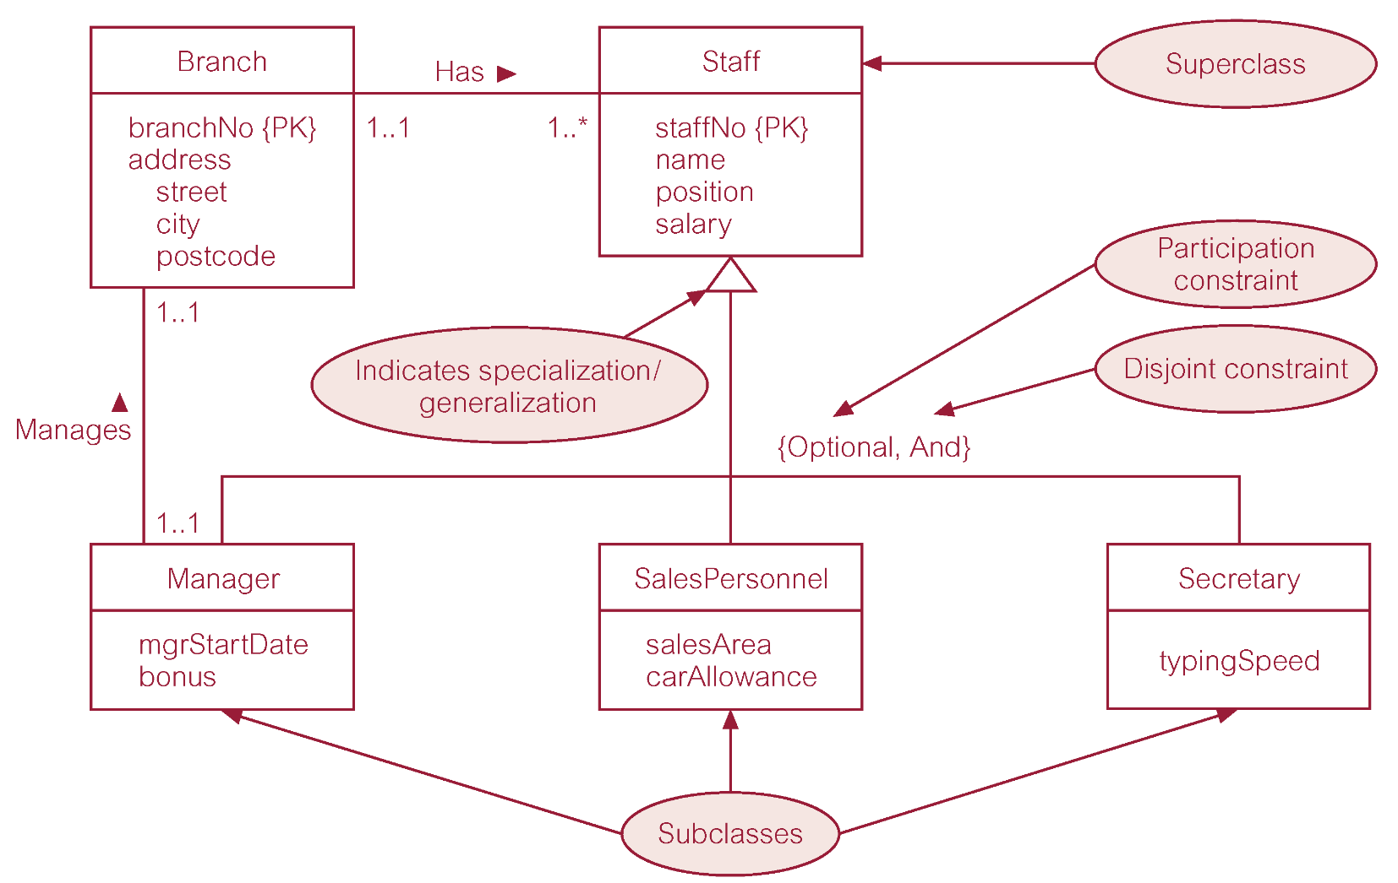
Specialization/generalization of Staff entity into subclasses representing job roles

Slide 10
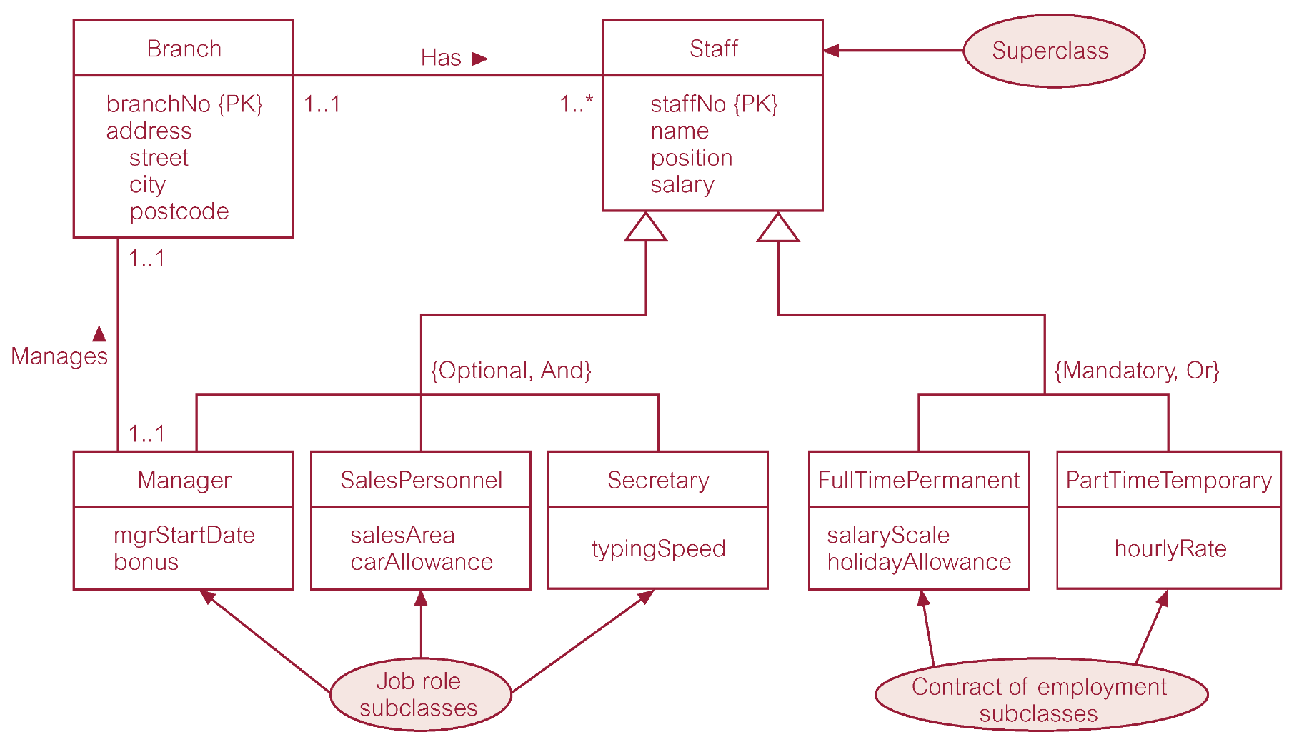
Specialization/generalization of Staff entity into job roles and contracts of employment

Slide 11
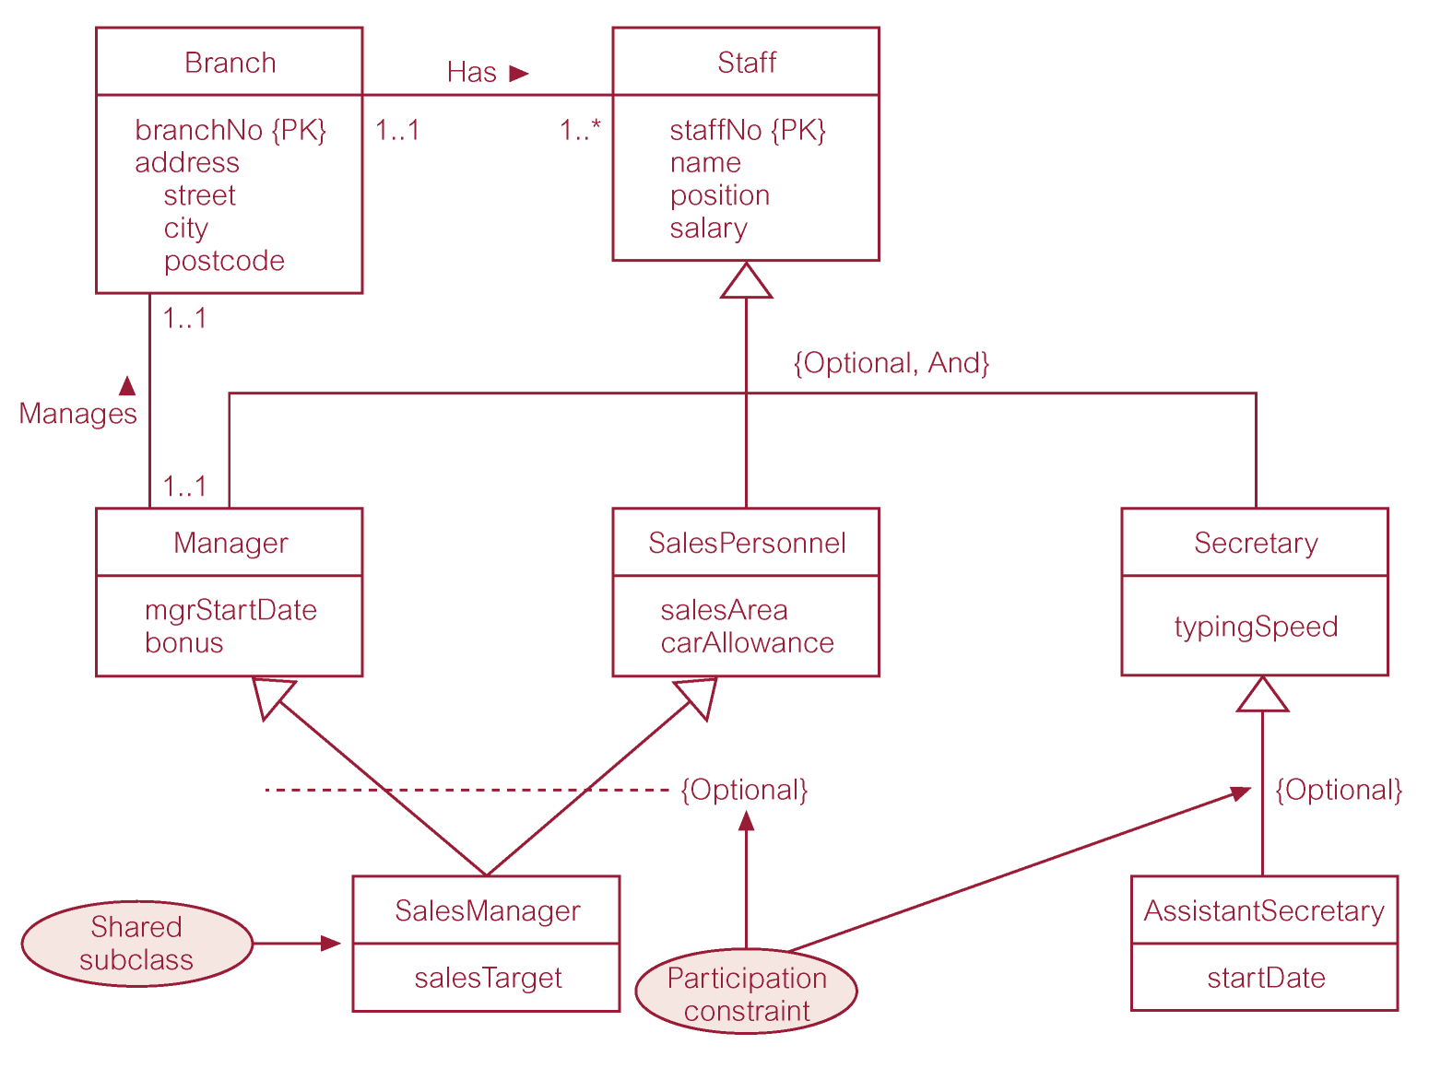
EER diagram with shared subclass and subclass with its own subclass

Slide 12
Constraints on Specialization / Generalization
Two constraints that may apply to a specialization/generalization:
  participation constraints
  disjoint constraints.
Participation constraint
  Determines whether every member in superclass must participate as a member of a subclass.
  May be mandatory or optional.

Slide 13
Constraints on Specialization / Generalization
Disjoint constraint
  Describes relationship between members of the subclasses and indicates whether member of a superclass can be a member of one, or more than one, subclass.
  May be disjoint or nondisjoint.

Slide 14
Constraints on Specialization / Generalization
There are four categories of constraints of specialization and generalization:
  mandatory and disjoint
  optional and disjoint
  mandatory and nondisjoint
  optional and nondisjoint.

Slide 15
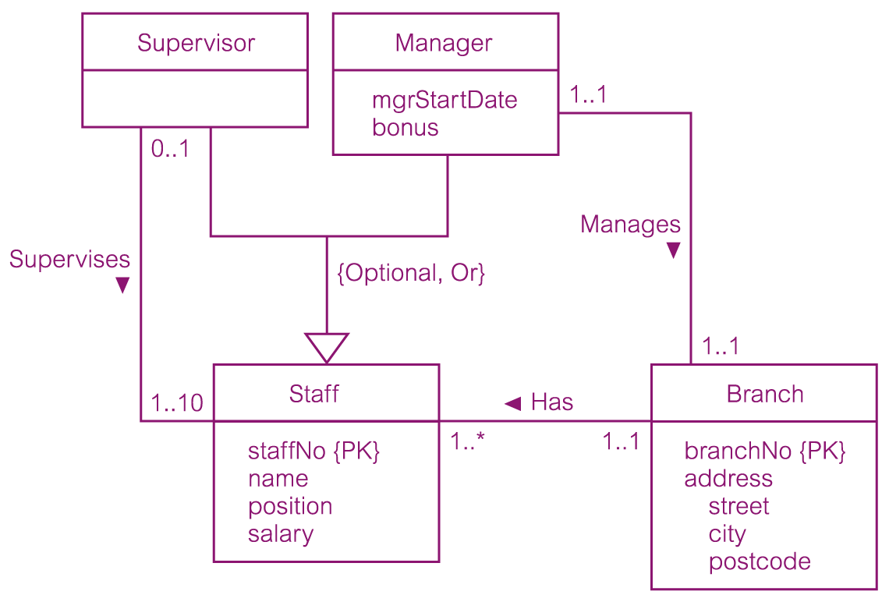
DreamHome worked example - Staff Superclass with Supervisor and Manager subclasses

Slide 16
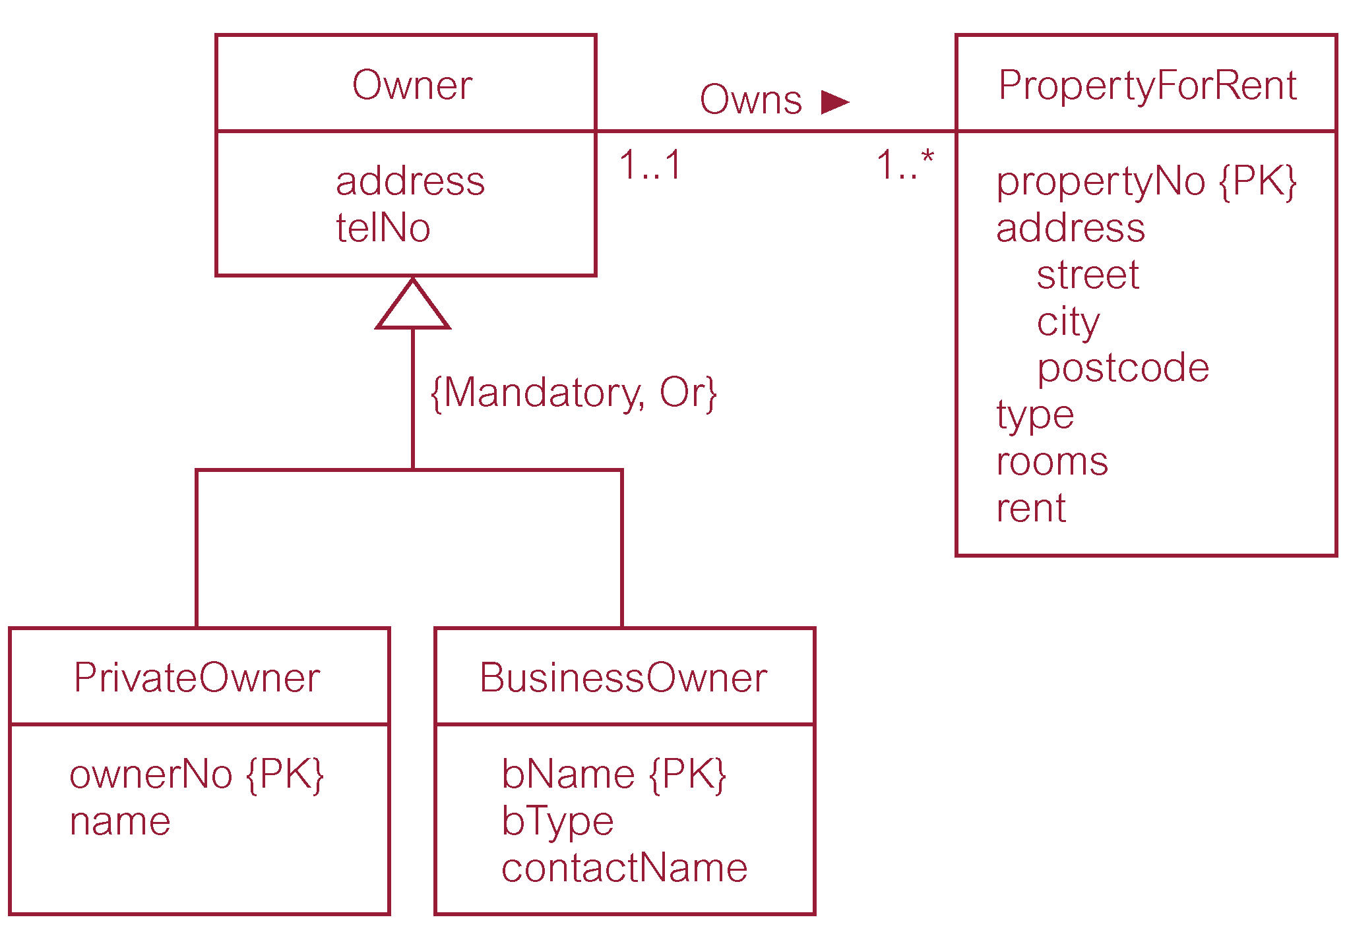
DreamHome worked example - Owner Superclass with PrivateOwner and BusinessOwner subclasses

Slide 17
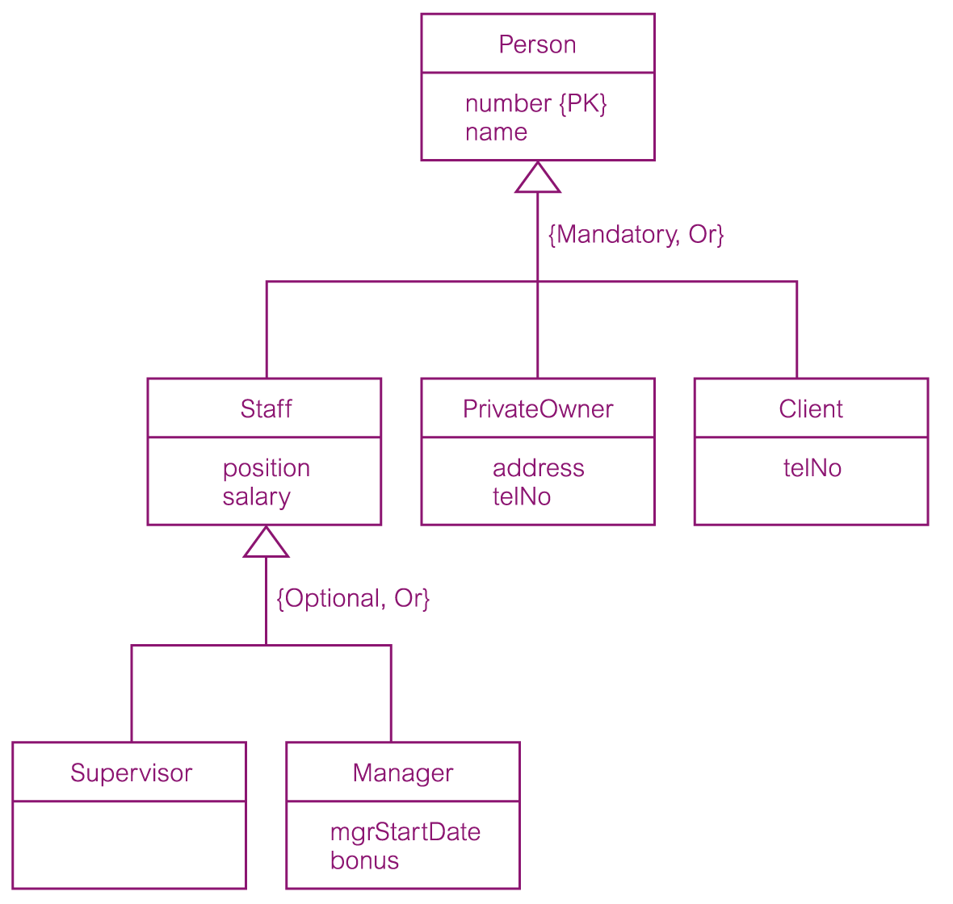
DreamHome worked example - Person superclass with Staff, PrivateOwner, and Client subclasses

Slide 18
For the teacher (Aggregation) :
1) Do page 397 – A
2) Page 398 – A, D
Composition – If the whole dies, the part also dies.
3) Do page 399 – Top figure.

Slide 19
Show STARUML
(Go to Model on top -> add diagram)
Do the Unity Chart.
Then do the next slide.

Slide 20
Try to start SQL_Server
on our machines.

